Slide 1



Welcome to
The Session Will Begin Shortly

Slide 2
START

Slide 3
Advanced Data Visualization
Workshop Lead: Han Yu
Facilitators: Adrien Osakwe &
César Miguel Valdez Córdova
Date: February 21, 2025

Slide 4


QLS-MiCM mission statement: deliver quality workshops designed to help biomedical researchers develop the skills they need to succeed.
Scan the QR code to sign up
for our mailing list
Contact: workshop-micm@mcgill.ca

Slide 5
Goals
Enhance Interpretability: Use transformations and faceting for better comparisons
Improve Clarity: Customize aesthetic to effectively communicate insights
Boost Engagement: Create interactive visualizations with plotly
Optimize Storytelling: Select the right plot types for your analysis

Slide 6
Outline
Brief Review of Basic Visualization in R
Why use ggplot 2
Structure of a ggplot2 command
Advanced Customization and Data Transformation
Data transformations and faceting
Customizing ggplot2 plots
Exercise 1
Advanced Visualization Techniques
Specialized plots
Introduction to interactive and dynamic visualizations
Exercise 2

Slide 7
Why Use ggplot2 Over Base R for Data Visualization?
With better aesthetic and higher efficiency
Feature | ggplot2 | Base R
Design Framework | Based on Grammar of Graphics, enabling layered construction | Procedural approach, harder to modify and extend
Customization | Themes and formatting (theme_*) for professional aesthetics | Requires manual adjustments using par() or axis()
Faceting | Built-in with facet_wrap() and facet_grid() | Requires manual layout setup
Syntax | Consistent and modular, easy to learn and maintain | Fragmented and less intuitive
Data Transformations | Directly supports scaling and slicing in plots | Preprocessing required before visualization
Multi-layered Plots | Allows layering of multiple plot types and elements | Complex to achieve with overlays
Interactivity | Seamless integration with interactive packages like plotly | Requires external packages with complex workflows
Notes:
Base R: often requires additional quantity of code, manual operation required

Slide 8
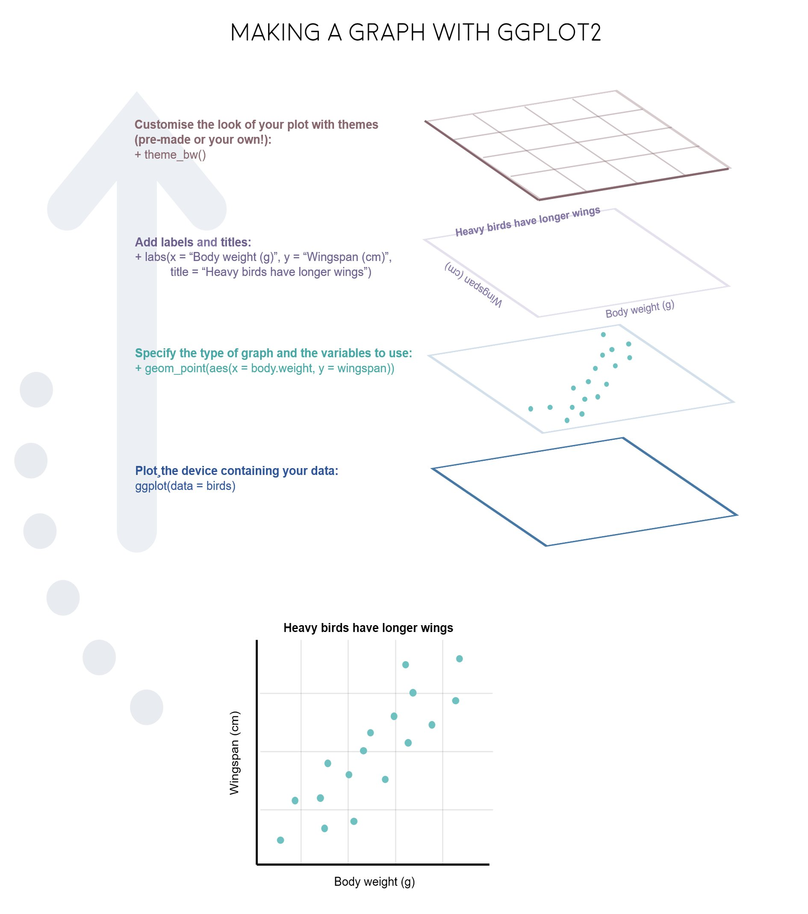
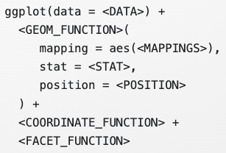
Overview of ggplot2
gg = “grammar of graphics”
Components in ggplot2:
Data
Aesthetic attribute (Aes)
Geometric object (Geom)
Stats
Position
Coord
Facet
Theme
……

Slide 9
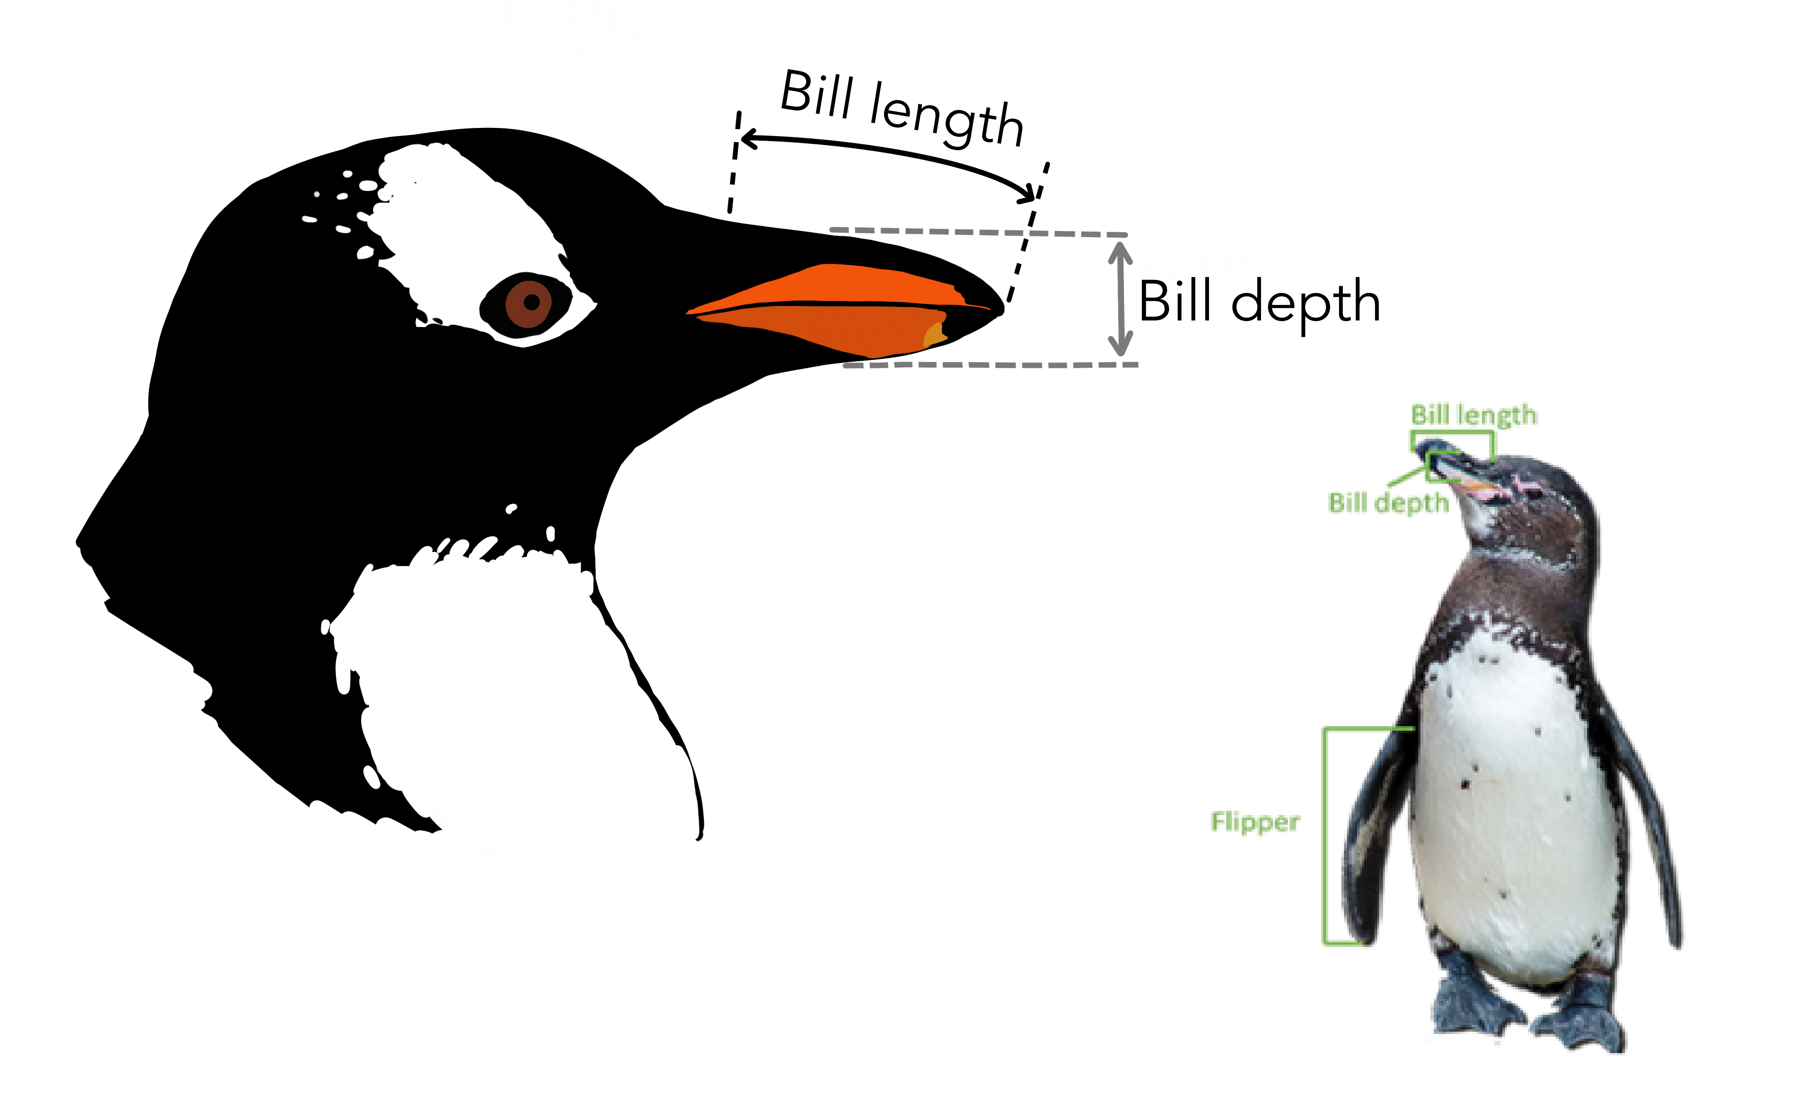
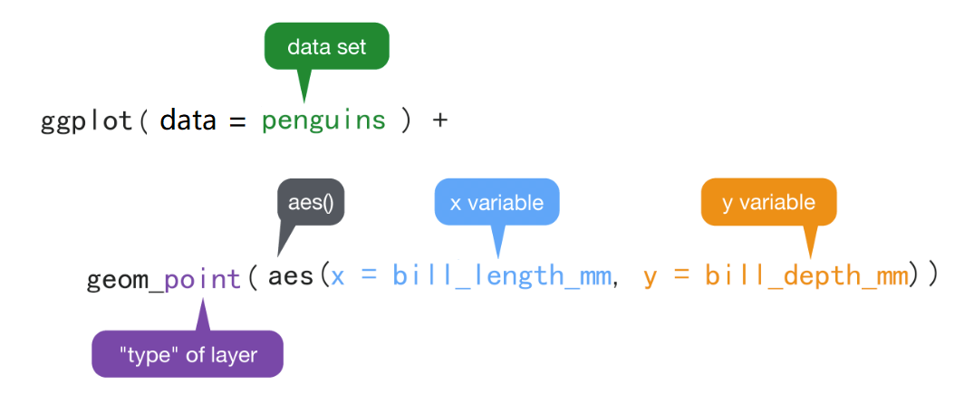
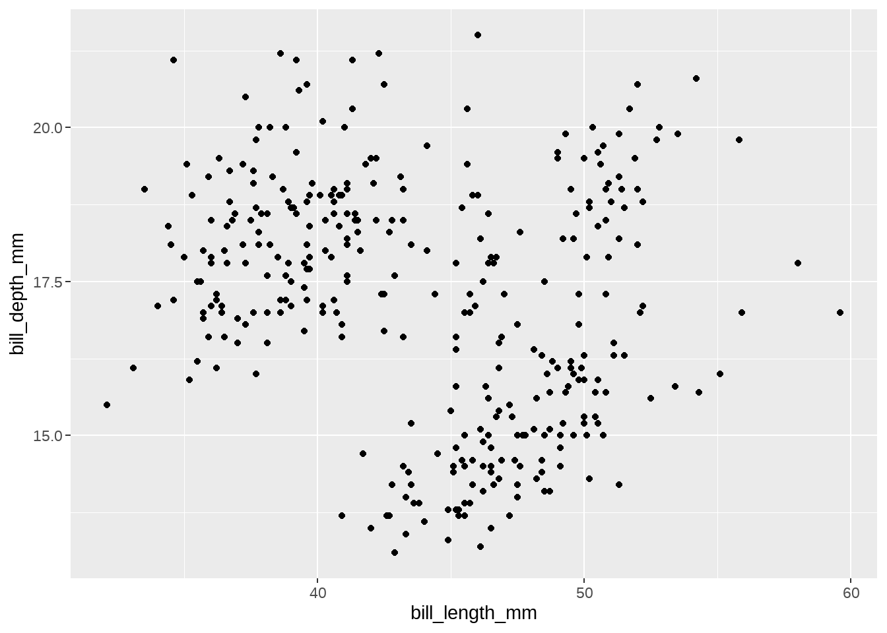
Structure of the ggplot2 command
Question:
The relationship between the bill length and bill
depth of the penguin?

Slide 10
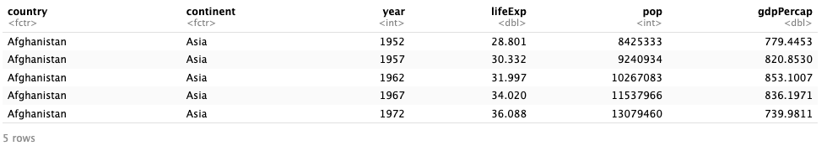
Dataset preparation
gapminder
1704 observations
6 variables
Country: a factor with 142 levels
Continent: a factor with 5 levels
Year: going from 1952 to 2007 in increments of 5 years
Pop: population
gdpPercap: GDP per capita
lifeExp: life expectancy

Slide 11
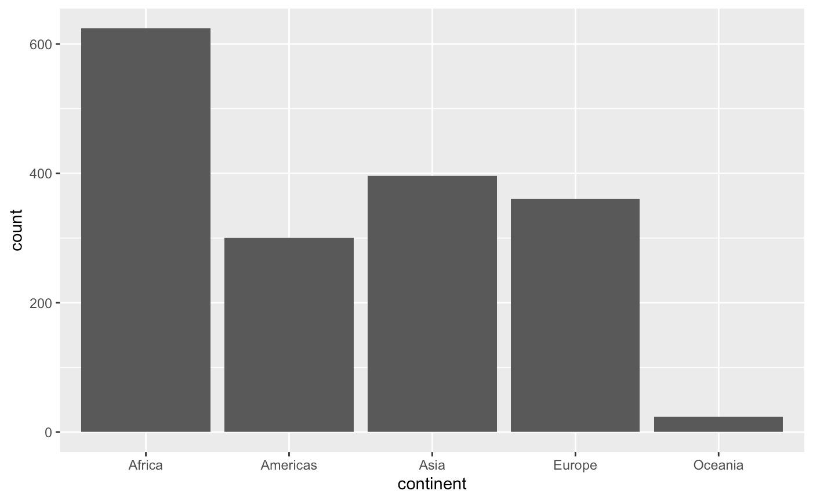
Bar plot
discrete variable
ggplot(gapminder, aes(x = continent)) + geom_bar()
Research Question:
How is the number of recorded observations distributed across different continents?

Slide 12
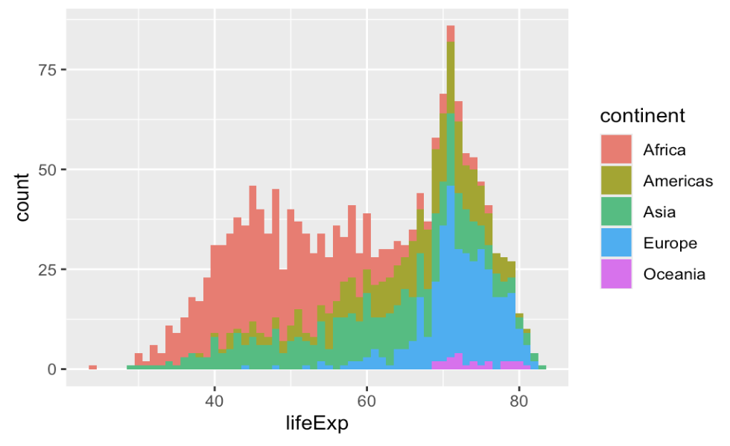
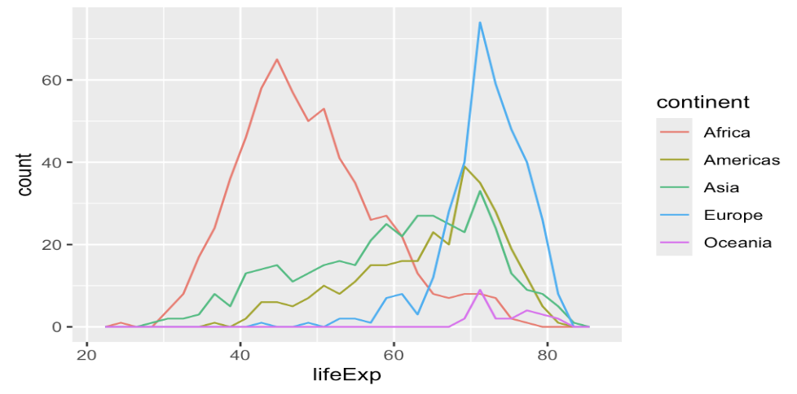
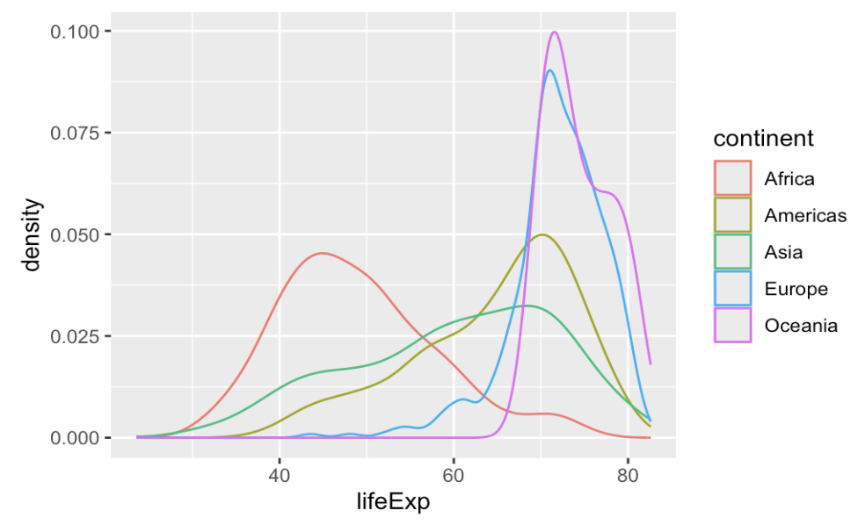
Histogram/ Frequency/ Density Plot
Choosing the right plot
To see raw counts and distribution shape -> Histogram
To compare multiple groups without overlap issues -> Frequency
To observe smoothed probability distributions and peaks -> Density
ggplot(gapminder, aes(x = continent)) +
geom_freqpoly()
ggplot(gapminder, aes(x = continent)) +
geom_density()
ggplot(gapminder, aes(x = continent)) +
geom_histogram(binwidth = 1)
Does the distribution of life expectancy in a continent suggest the presence of two distinct groups?
What is the overall distribution of life expectancy?
How do the distributions of life expectancy compare across different continents?
Notes:
Histogram:
Key features:
Use bars to represent data distribution
The bin width affects how detailed the distribution appears
Data interpretation:
Africa(red) dominates lower life expectancy (30-50 years)
Europe(blue) and Americas (green) have peaks at higher life expectancy
Best use case:
Quick overview of distribution and stacking of data of different categories
Frequency:
Key features:
Use lines instead of bars, maintaining the count
Visualize trends more clearly than stacked histograms
Lines are separated for better category comparison
Data Interpretation:
Peaks are more evident: Europe (blue) peaks around 75 years, while Africa (red) has a broad distribution below 50 years
Americas (green) and Asia (cyan) have wider distributions between 50 and 70 years
Best use case:
Comparing multiple groups when stacked histograms obscure distinctions
Density:
Key feature:
Smooth curves, y-axis: probability density not count
The area under each curve sums to 1, making it a relative rather than absolute representation
Data interpretation:
Africa (red) has a strong peak at 40-50 years
Europe (blue) is concentrated around 75+ years, with a narrow peak, indicating less variation
The Americas (green) and Asia (cyan) are more spread out, peaking near 60 years
Best use case:
Focus more on the group distribution instead of the comparison of absolute value between each group

Slide 13
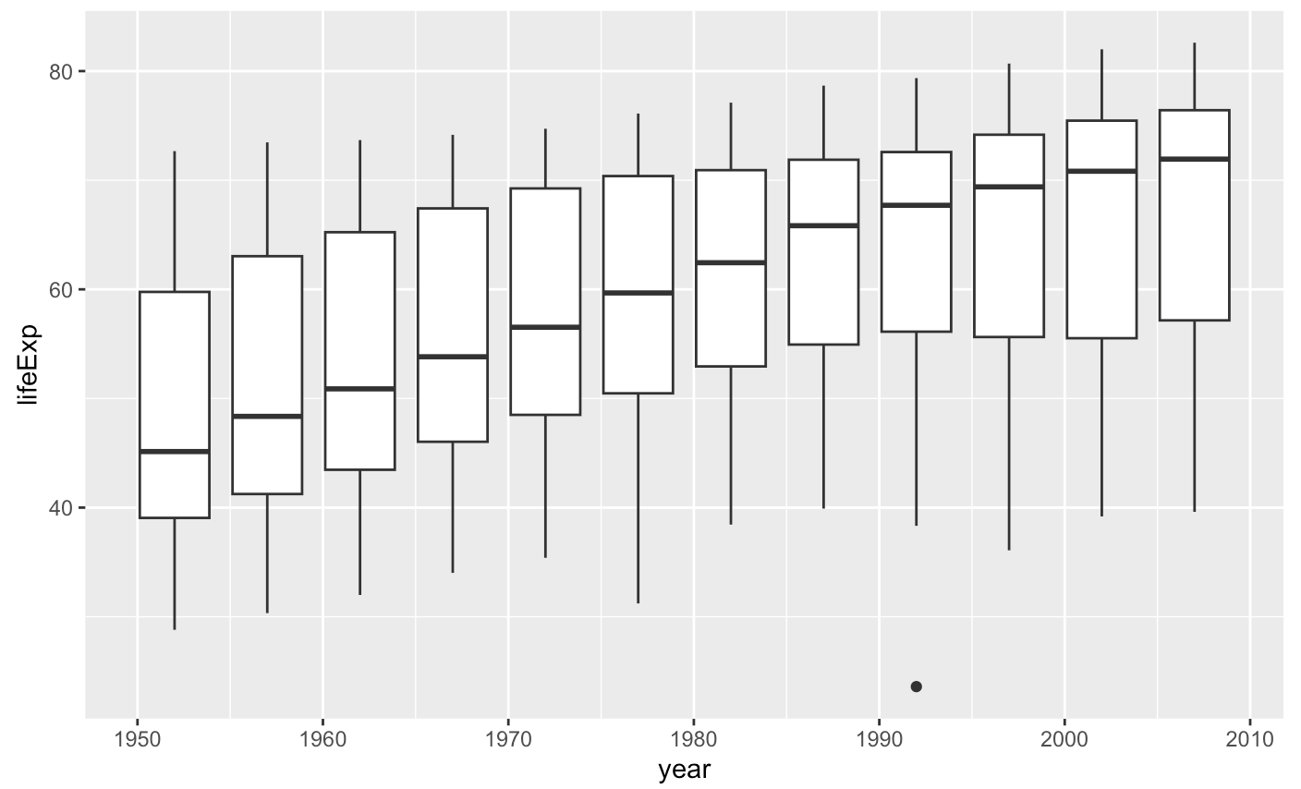
Box plot
one discrete variable + one continuous variable
ggplot(gapminder, aes(x = year, y = lifeExp)) + geom_boxplot(aes(group = year))
Research Question:
How has life expectancy changed over time?

Slide 14
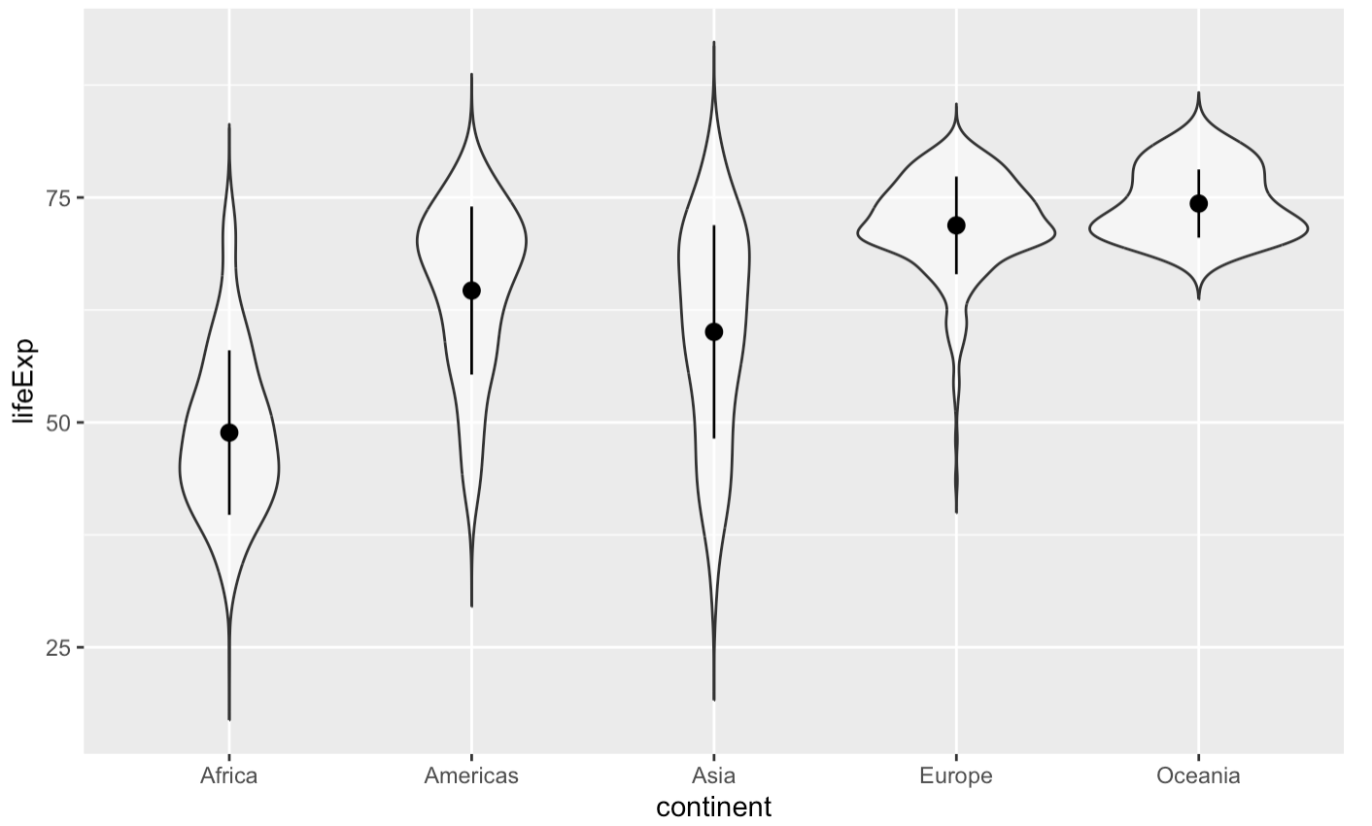
Violin plot
A combination of a box plot and a density plot
ggplot(gapminder, aes(x = continent, y = lifeExp)) + geom_violin(trim = FALSE, alpha = 0.5)
Research Question:
How does the distribution and variability of life expectancy differ across continents?
Notes:
Disadvantage：can be misleading if the dataset is small and more complex to interpret than the density of box plot
If your goal is to visualize the shape of a single distribution, use a density plot. If your goal is to compare distributions across multiple categories, use a violin plot.
If you want to explore whether a continent has two distinct life expectancy groups, the violin plot is better than the density plot because it allows easy comparison between continents and shows multimodal distributions more clearly.

Slide 15
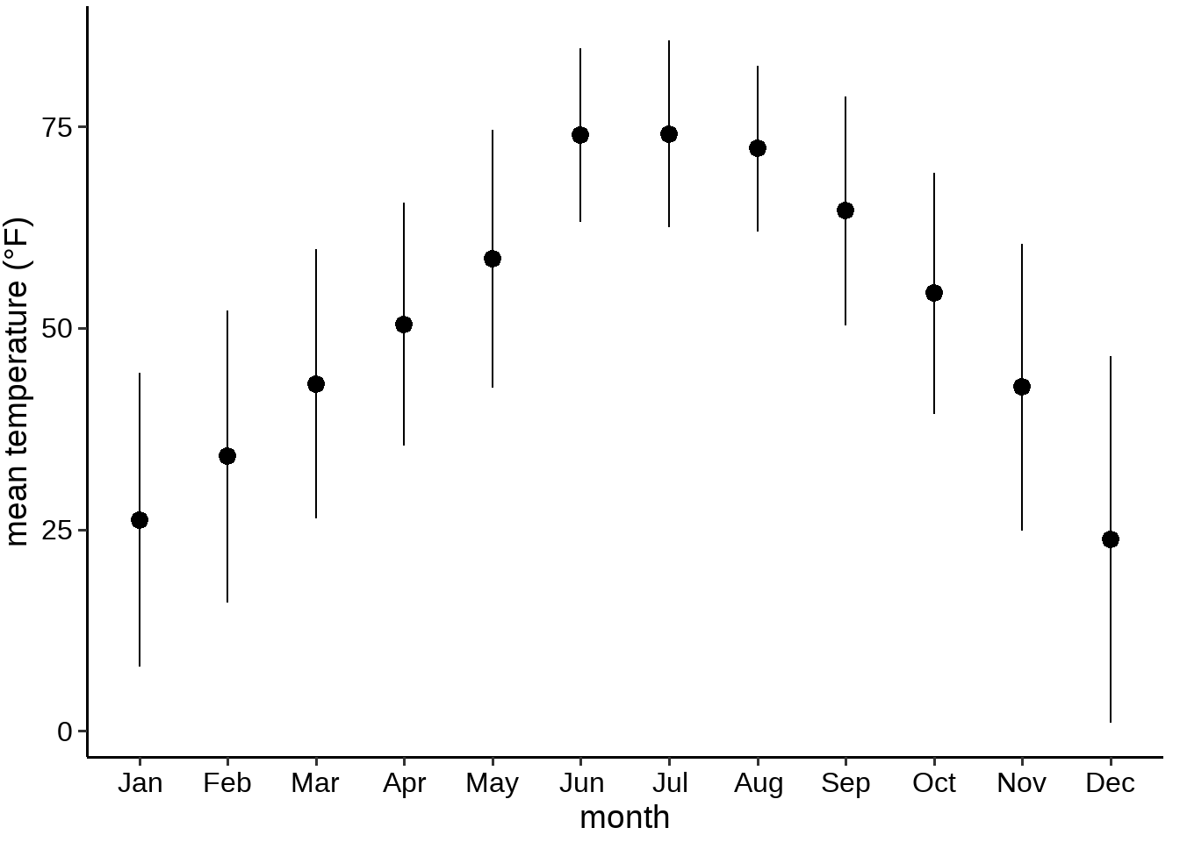
What questions do you have about this plot?
Notes:
The figure only uses one point and two error bars, which loses a lot of distribution information.
The reader cannot intuitively understand the meaning of this point (is it the mean or the median?)
The meaning of the error bar is unclear (standard deviation? Standard error? Or something else?)
Real data is often skewed, but the error bars of this graph are almost symmetrical. Can this represent the distribution of real data?

Slide 16
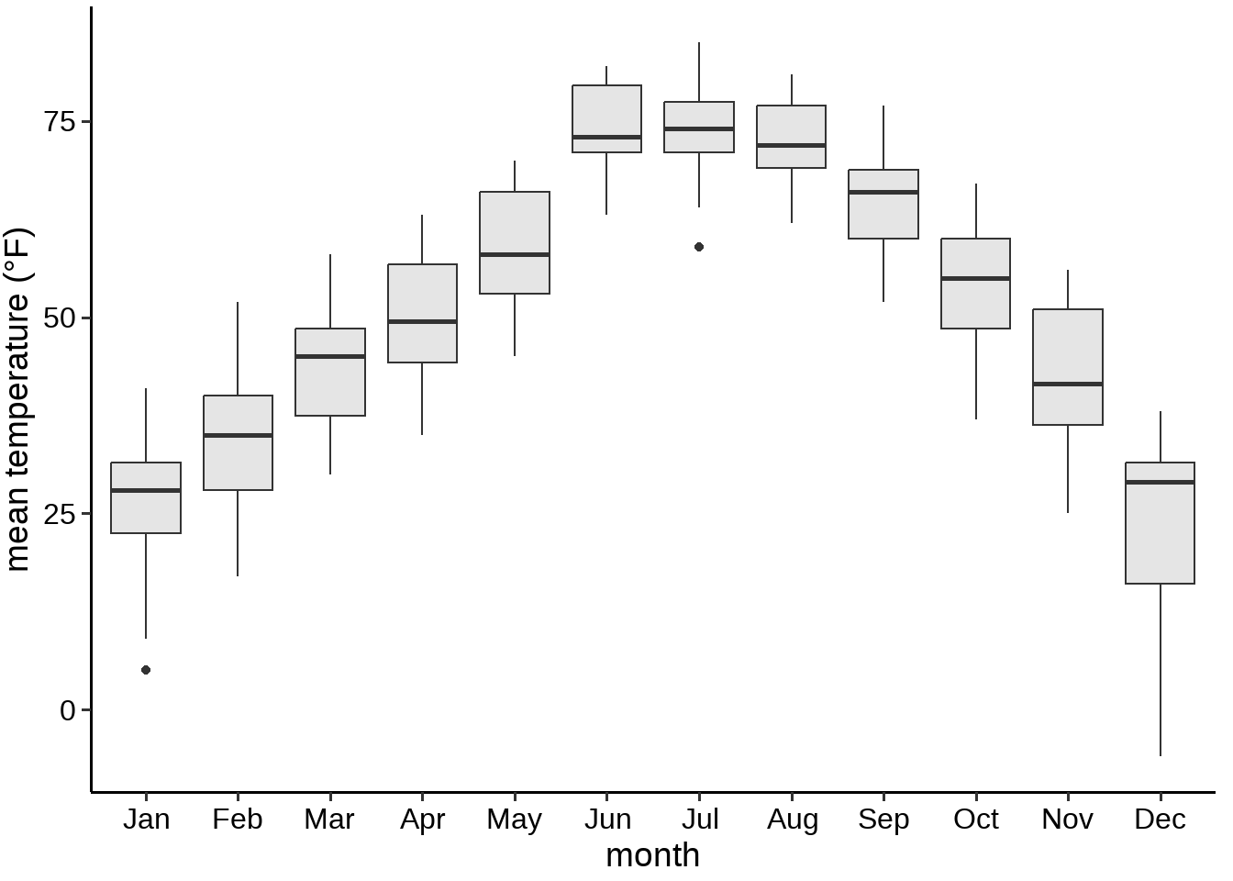
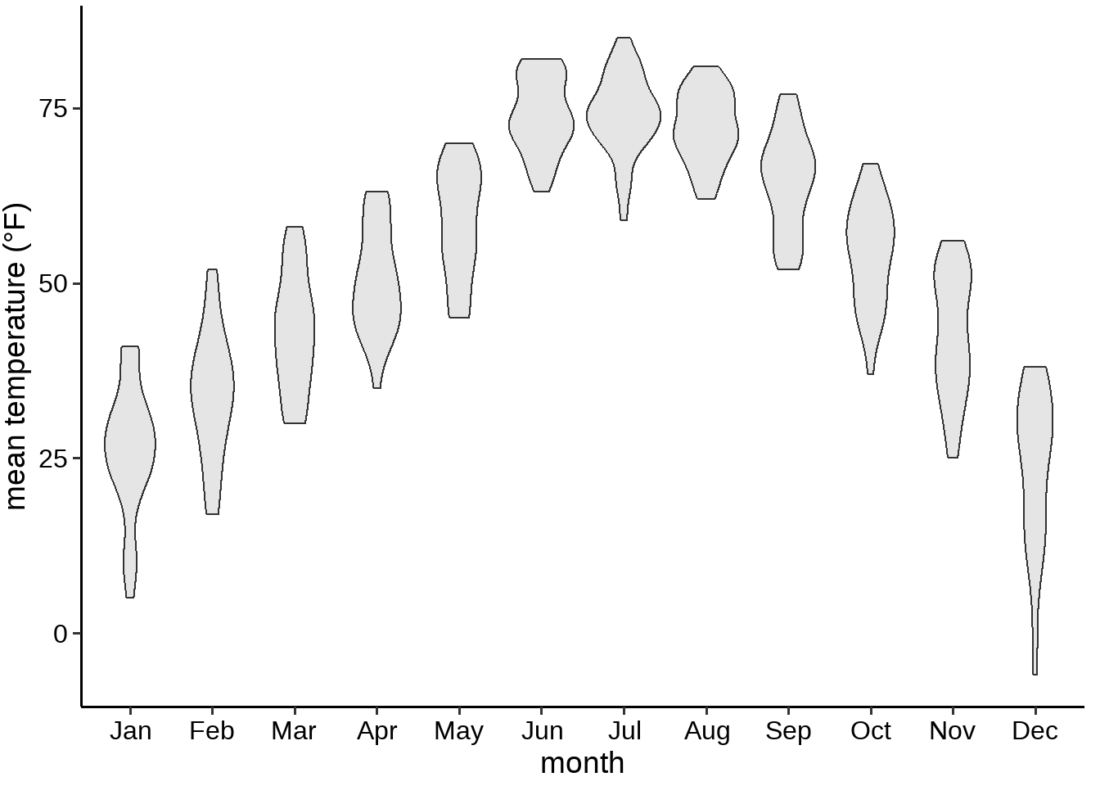
Next step: box/violin plot to show the distribution
What is the problem of the violin or box plot?

Slide 17
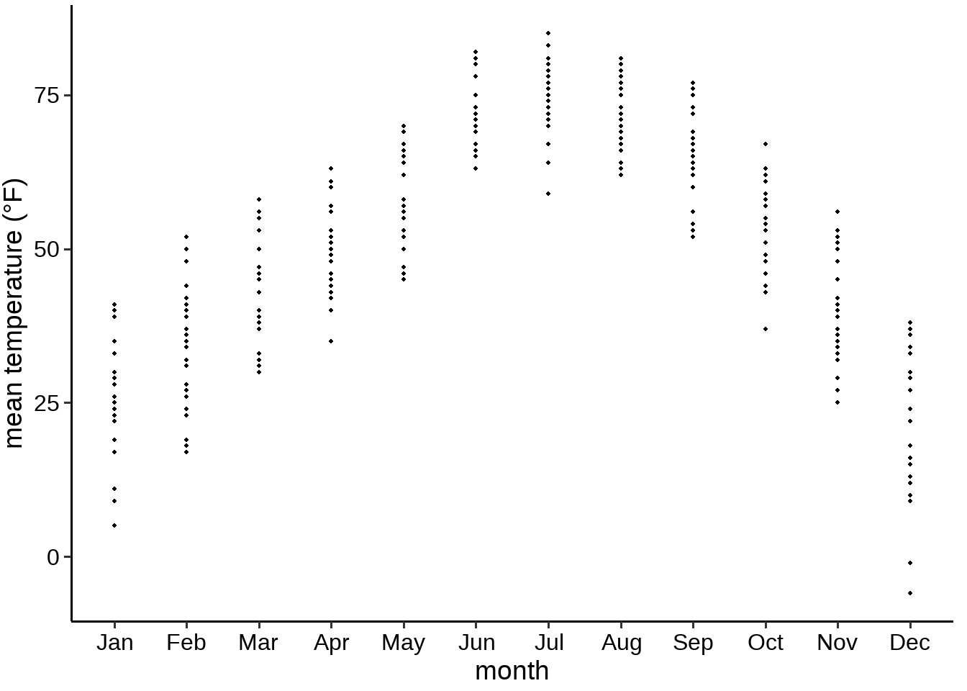
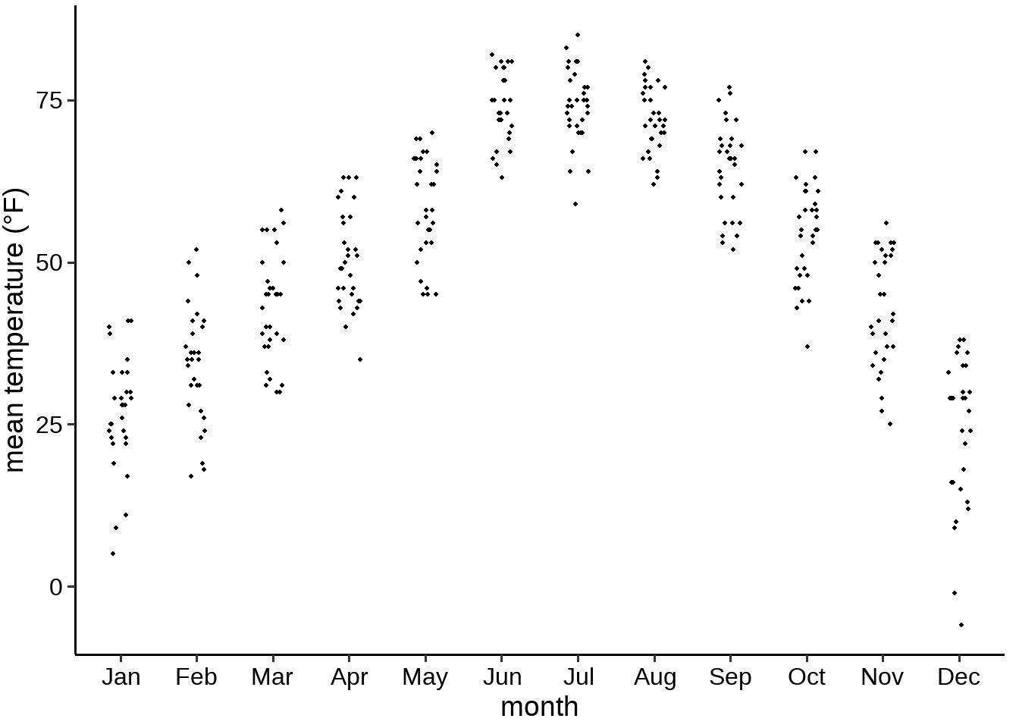
Show raw data points

Slide 18
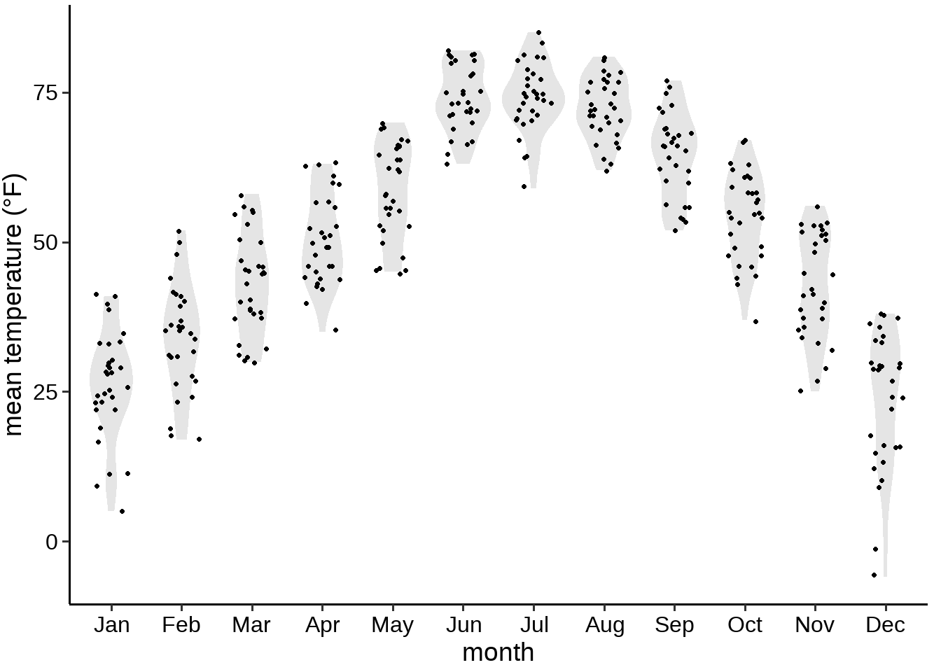
Before and after plots

Slide 19
Data Transformation and Advanced Customization

Slide 20
Data Transformation
 | Why? | functions
Data reshaping | useful for faceting or grouping variables | tidyr::pivot_longer() tidyr::pivot_wider()
Filtering rows and select columns | To focus on relevant data for a clearer visualization. To remove noise or unnecessary categories. | dplyr::filter() dplyr::select()
Aggregation and summarization | Transforming raw data into summarized statistics for better visualization. | dplyr::group_by() dplyr::summarize()
Normalization and scaling | Adjusting numerical values to ensure fair comparisons. Log transformation Min-max scaling Z-score standardization | dplyr::mutate() scale_x_log10()
Binning (Discretization) | Dividing a continuous variable into discrete categories to visualize distributions more clearly (e.g., in histograms or heatmaps). | dplyr::mutate()
Notes:
In data visualization, data transformation is a crucial step to ensure that the data is in the right format and structure for effective visual representation.
Why Do Data Transformation in Visualization?
Raw data is often not ready for direct visualization.
Effective visualizations require well-structured data.
Data transformation helps uncover meaningful insights.

Slide 21
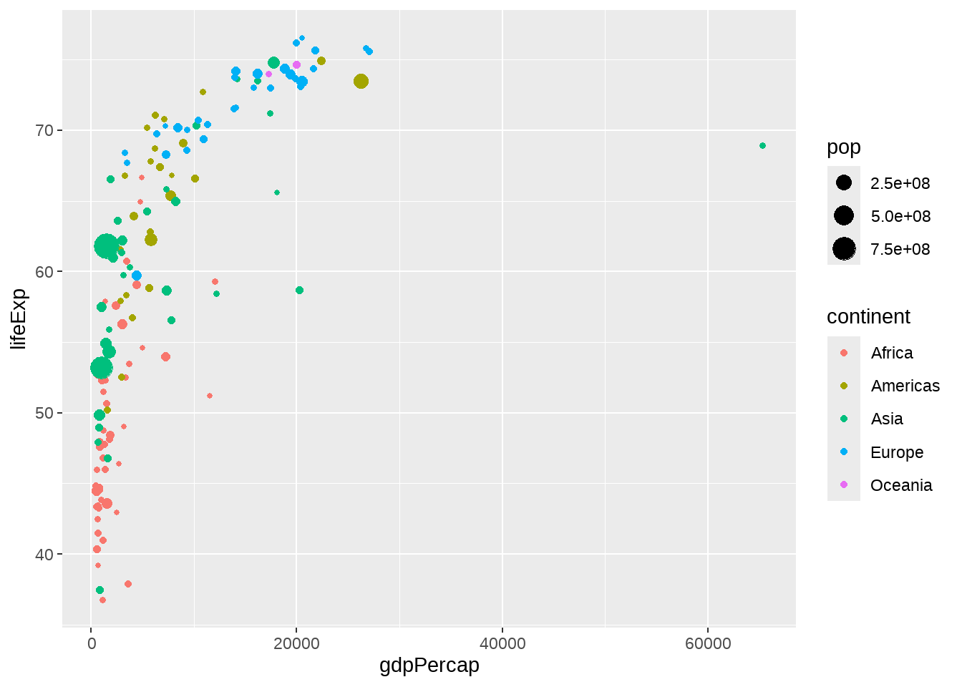
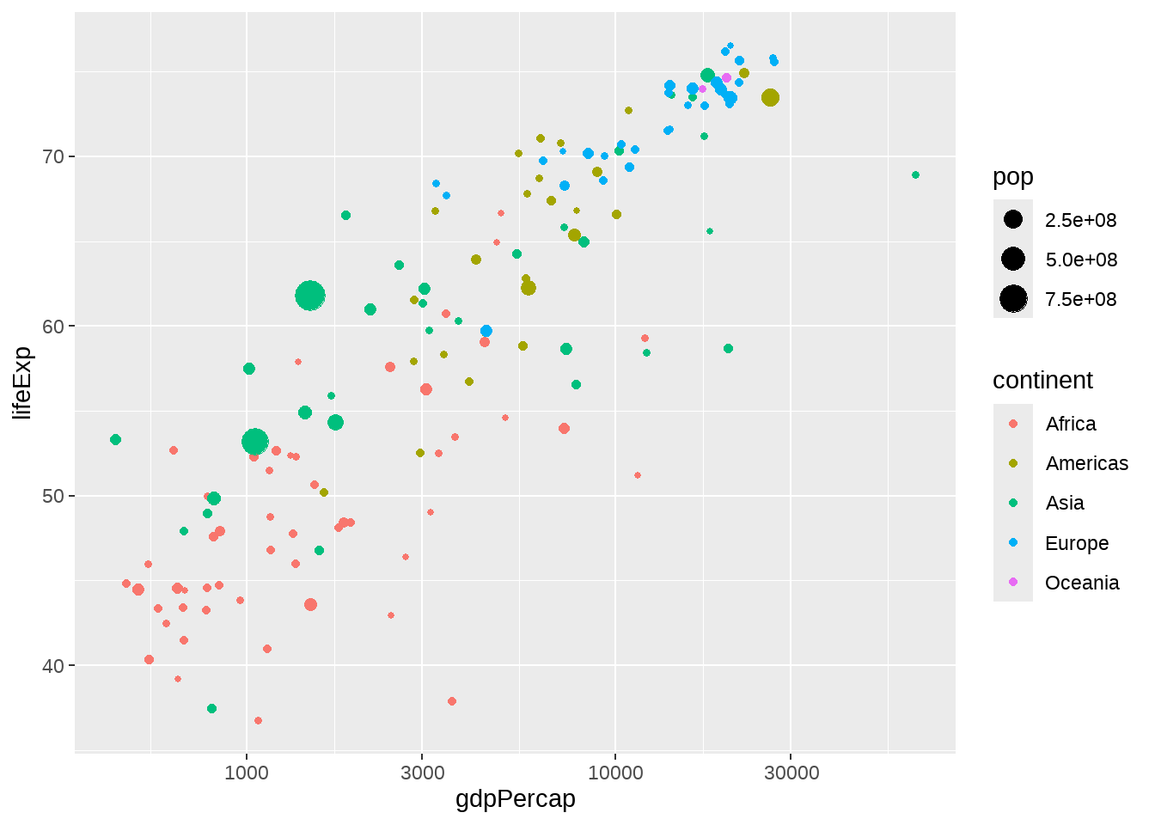
Data Transformation – log transformation
Research Question: How does GDP per capita relate to life expectancy across different continents?
+ scale_x_log10()
Notes:
GDP per capita variable is typically highly skewed, especially with a few countries having very high GDPs, which can make the plot hard to interpret. The points with high GDP values might dominate the visual representation.
Different breaks and labels are used to improve the readability and interpretation of the log-transformed axis (e.g., using dollar format or unit format to label the axis).

Slide 22
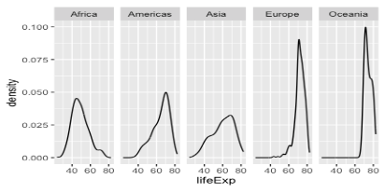
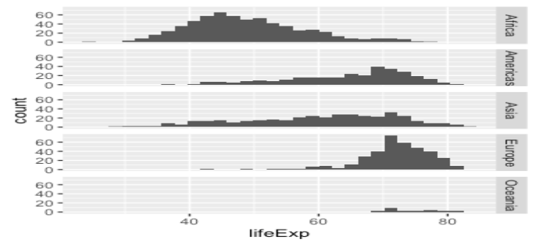
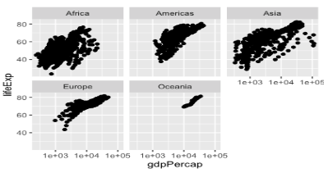
Data faceting
+ facet_grid(. ~ continent)
+ facet_grid(continent ~ .)
Facet_grid()
create a grid of graphs, by rows and columns
+ facet_wrap(~continent)
Choose grid:
Compare categorical variables systematically
The number of facet levels is not too large
Choose wrap:
Flexible and space-efficient
Facet_wrap()
create small multiples by “wrapping” a series of plots

Slide 23
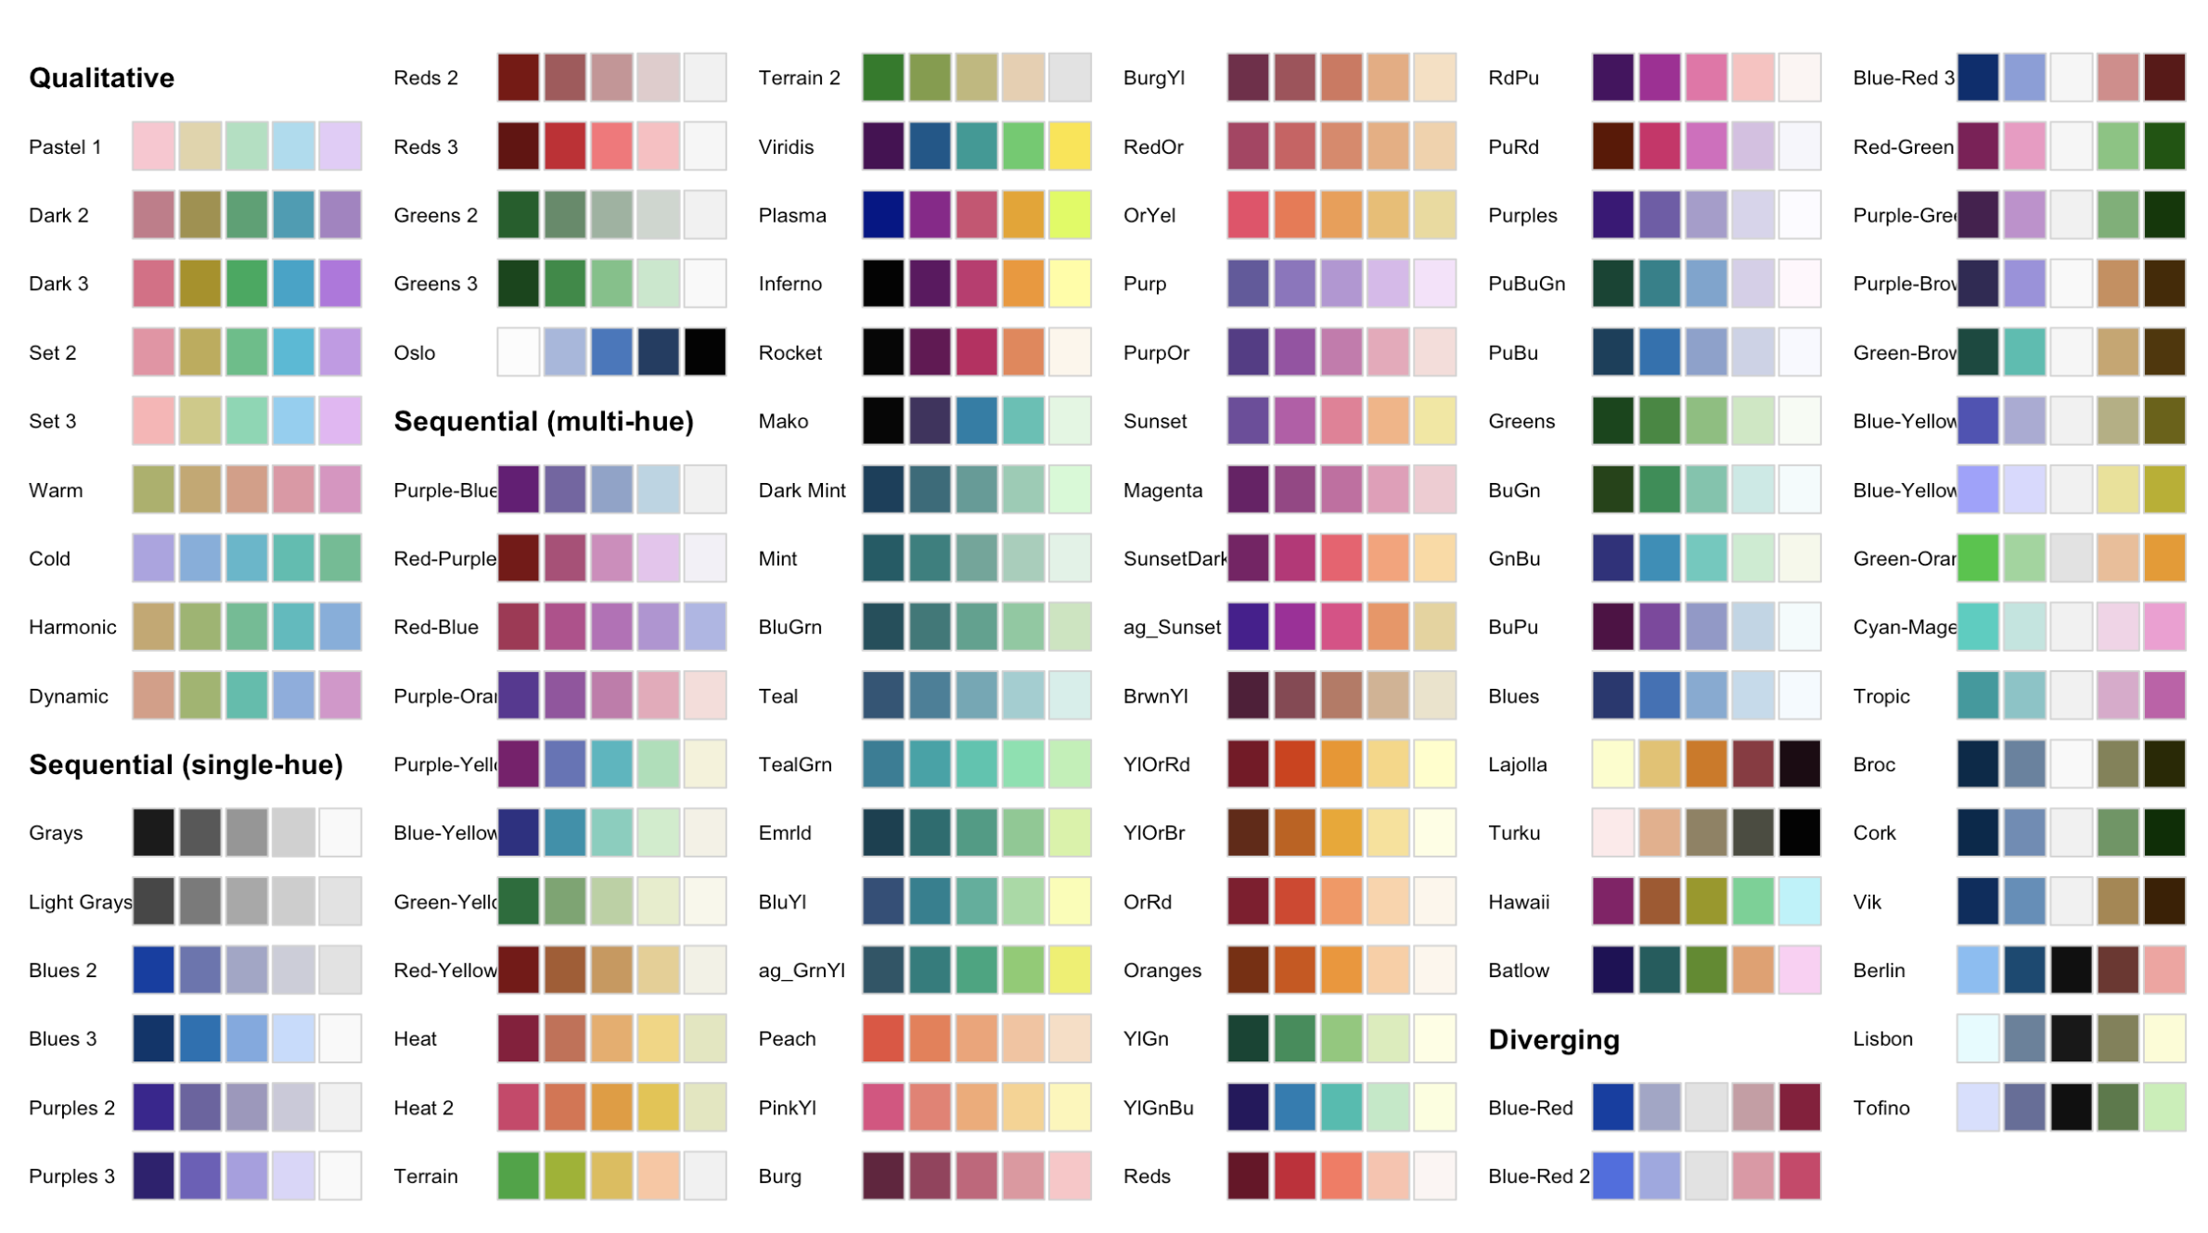
Aesthetic customizations – color palettes
colorspace
Qualitative: categorical variables
qualitative_hcl()
Sequential: ordered/continuous numerical variables
sequential_hcl()
Diverging: ordered/continuous numerical variables
diverging_hcl()
Don’t use bidirectional (diverging) color scales for unidirectional data!

Slide 24
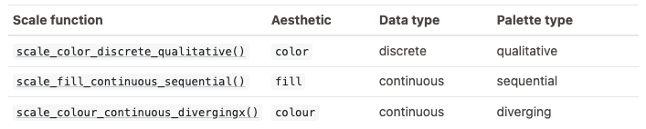
How to use colorspace in ggplot2
scale_<aesthetic>_<datatype>_<colorscale>()

Slide 25
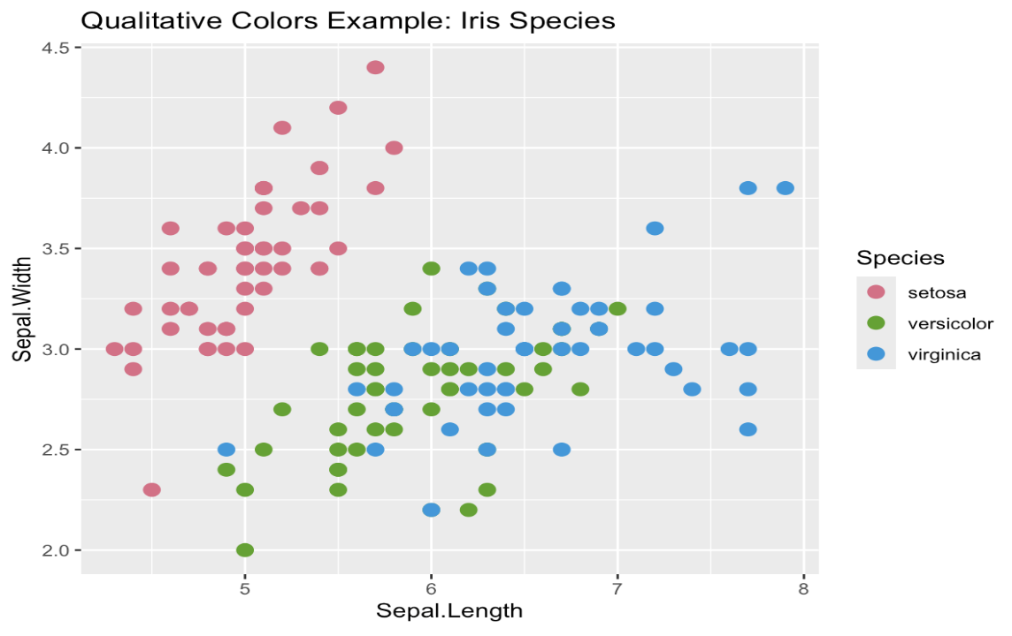
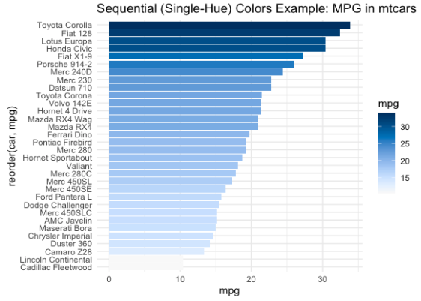
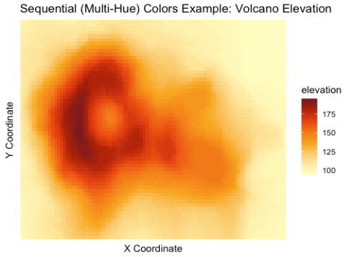
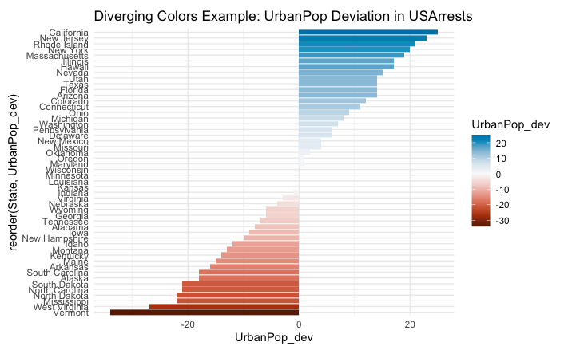
Colorspace examples
Notes:
Qualitative (iris dataset) : create a scatter plot of Sepal.Length vs. Sepal.Width, coloring points by Species
Sequential single-hue (mtcars dataset): create a bar plot of car models (rownames(mtcars)) based on their miles per gallon (mpg), using a single-hue sequential color gradient.
Sequential multi-hue (volcano dataset): The volcano heatmap provides a 2D topographic view of elevation data using color intensity. It highlights how terrain elevation changes over space
Diverging (USArrests dataset): map UrbanPop deviation from the median across states using a diverging color scale. The goal is to understand how each state's urban population percentage compares to the median urban population percentage. A positive value means the state's urban population is above the median, while a negative value means it is below the median.

Slide 26
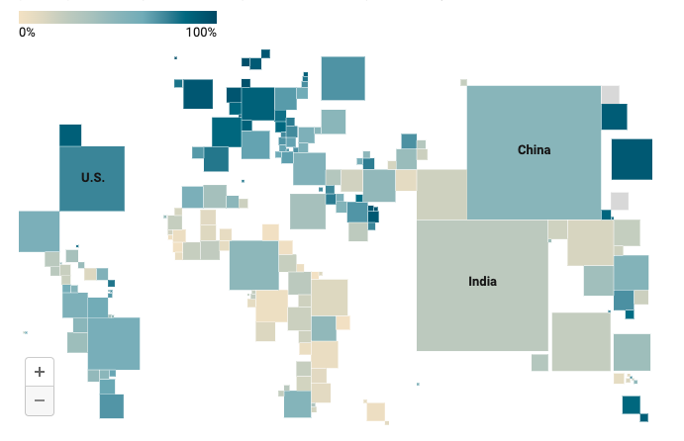
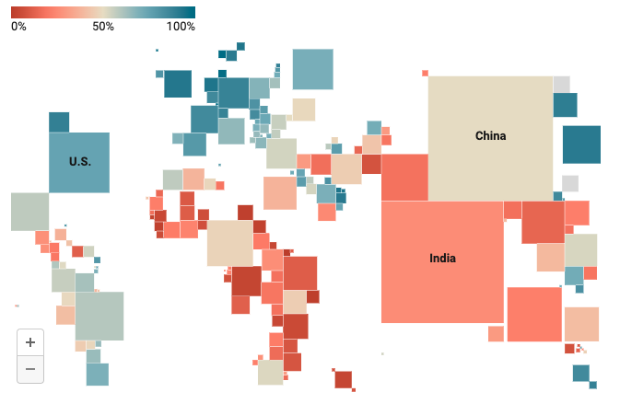
How to choose diverging and sequential color scale?
Use diverging shades if there’s a meaningful middle point
Use diverging shades to emphasize the extremes
Use diverging shades to let readers see more differences in the data
https://blog.datawrapper.de/diverging-vs-sequential-color-scales/

Slide 27
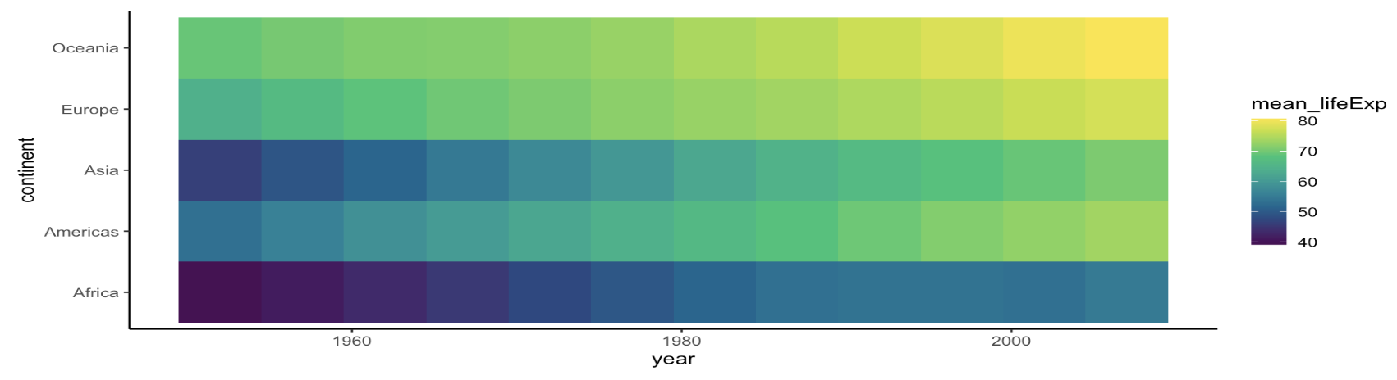
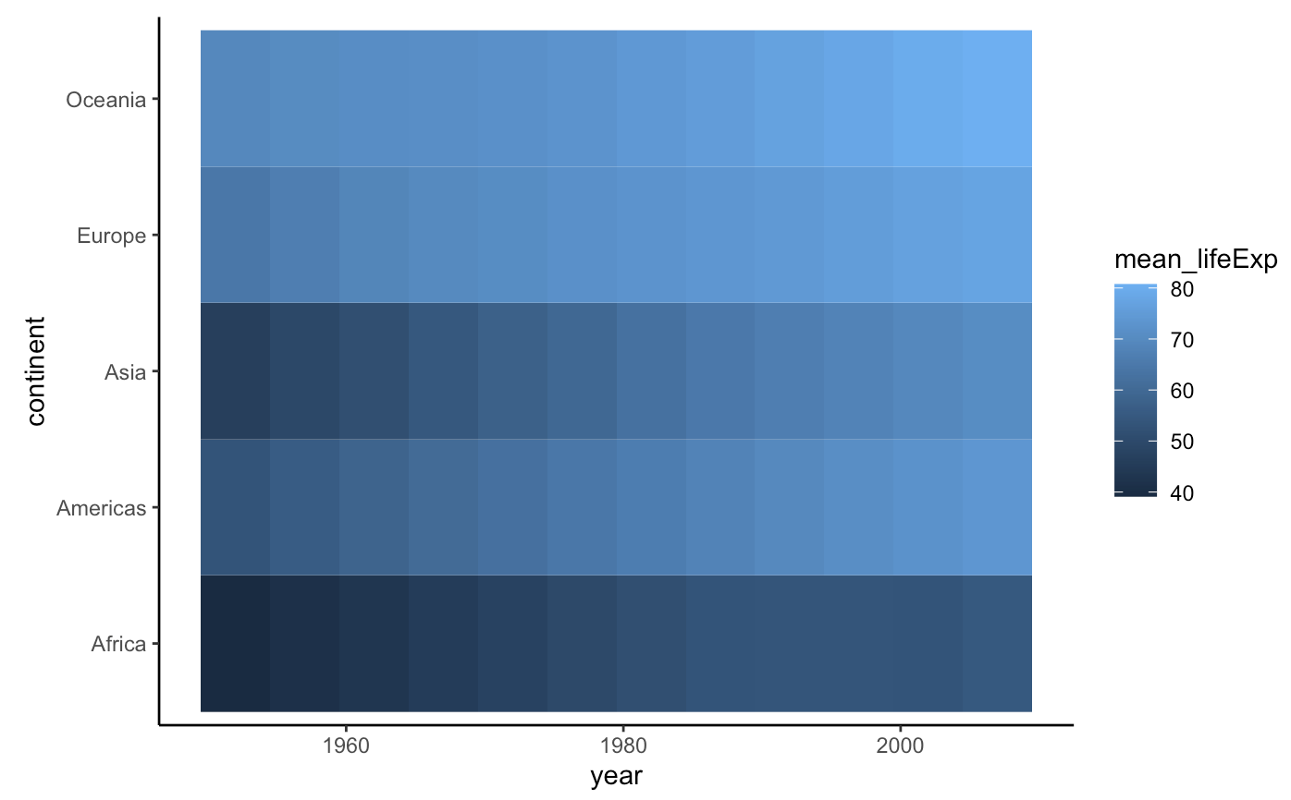
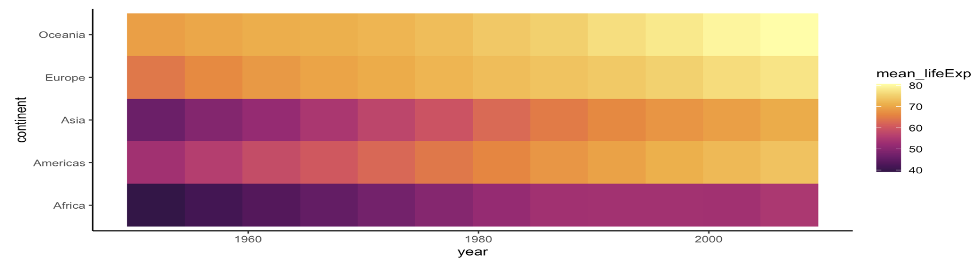
Select the appropriate color palettes for heatmaps
scale_fill_continuous_sequential(palette = "Viridis", rev = FALSE)
scale_fill_continuous_sequential(palette = ”Inferno", rev = FALSE)

Slide 28
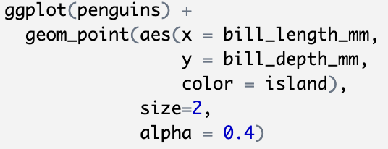
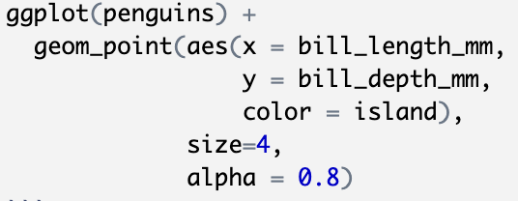
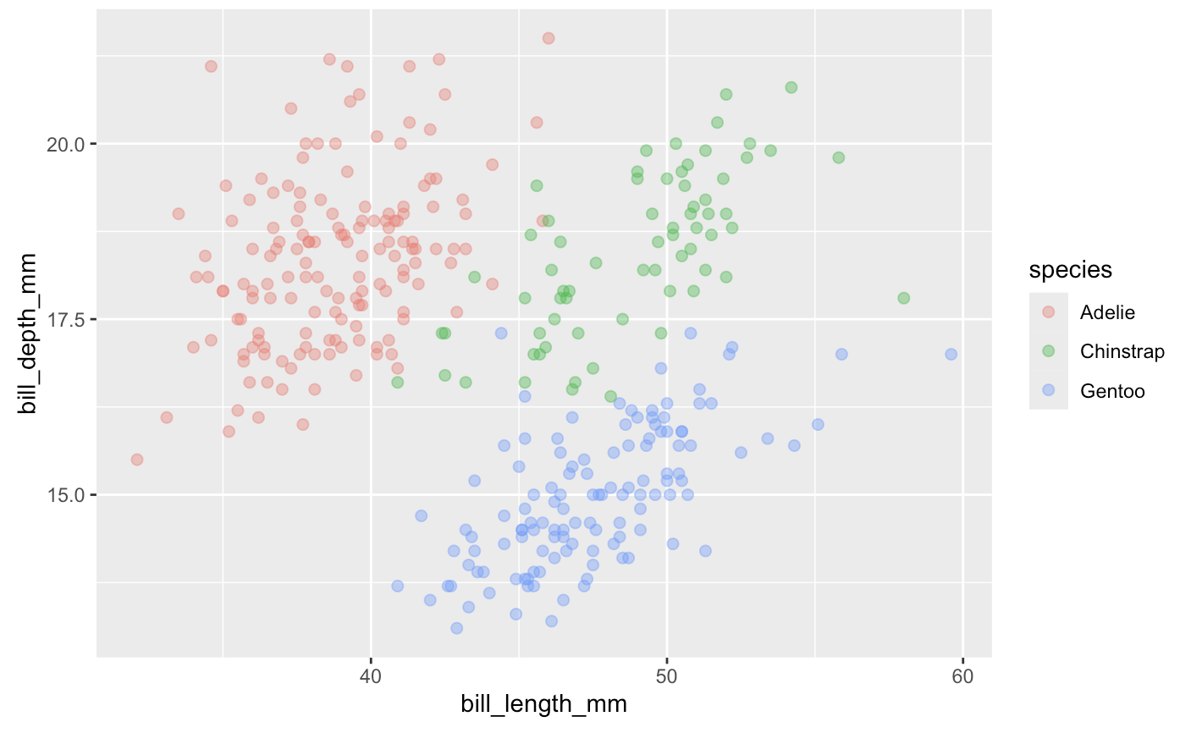
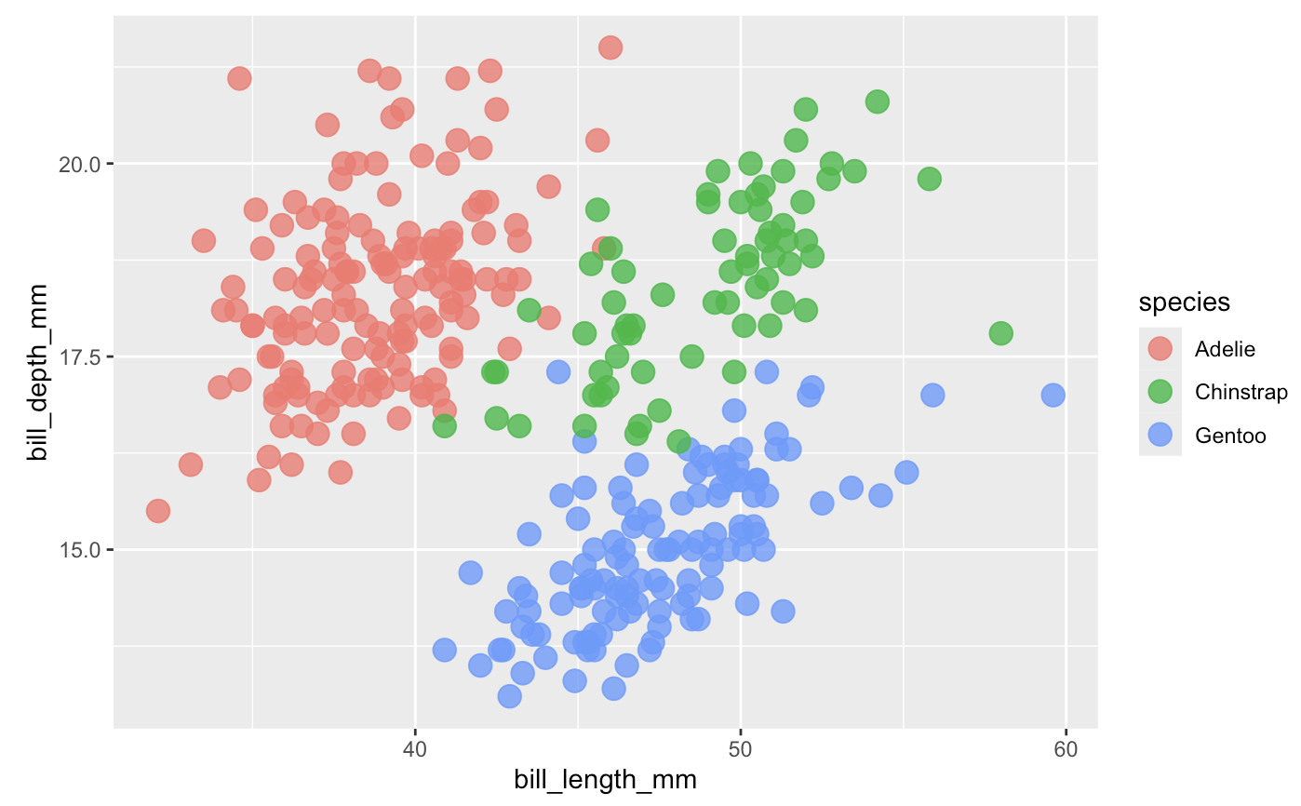
How to change size of points and transparency
Transparency:
alpha = number between 0 (completely transparent) and
1(completely opaque)
Size of points: size

Slide 29
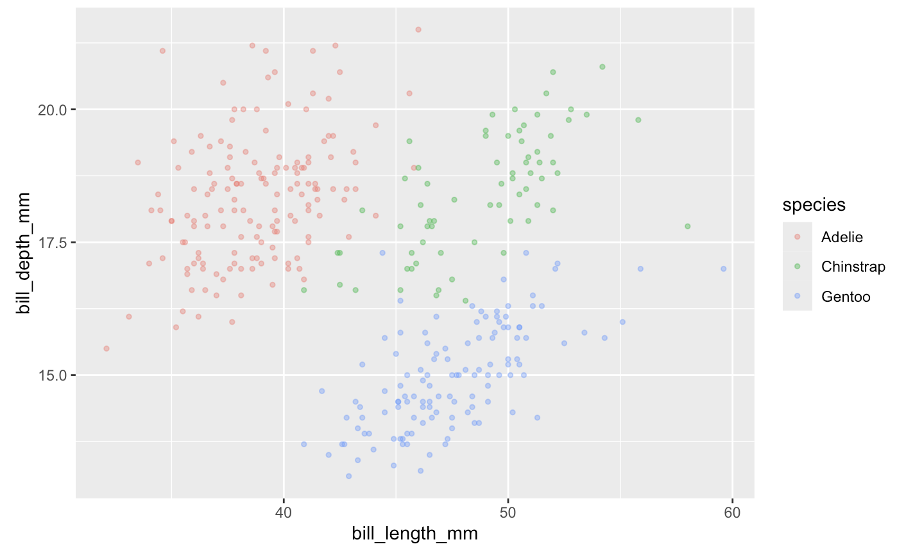
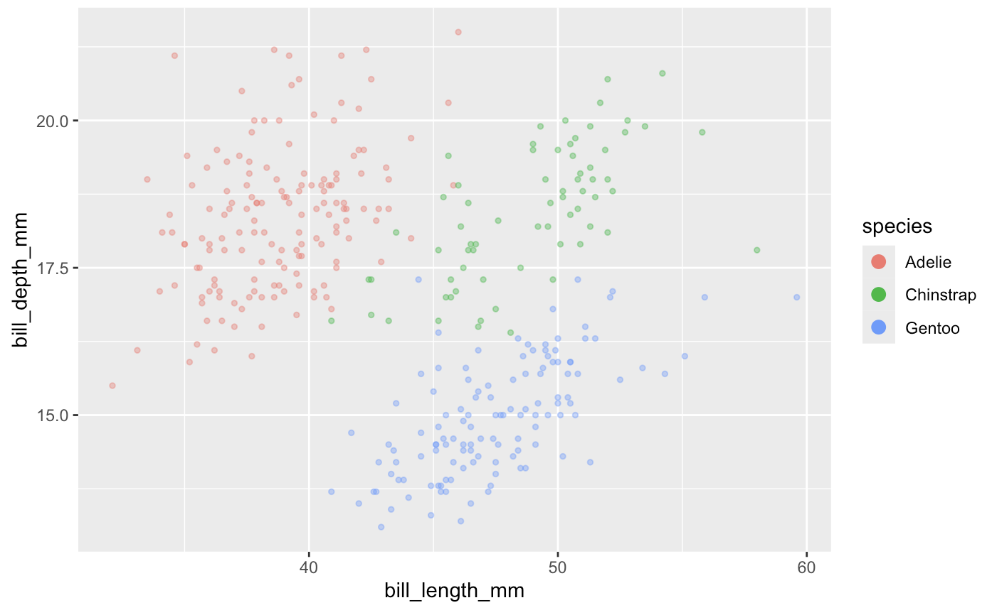
Adjust the appearance of the legend
+ guides(color = guide_legend(
override.aes = list(size = 3, alpha = 1))
)

Slide 30
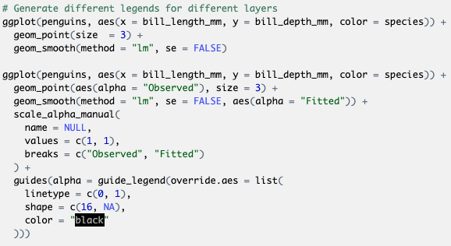
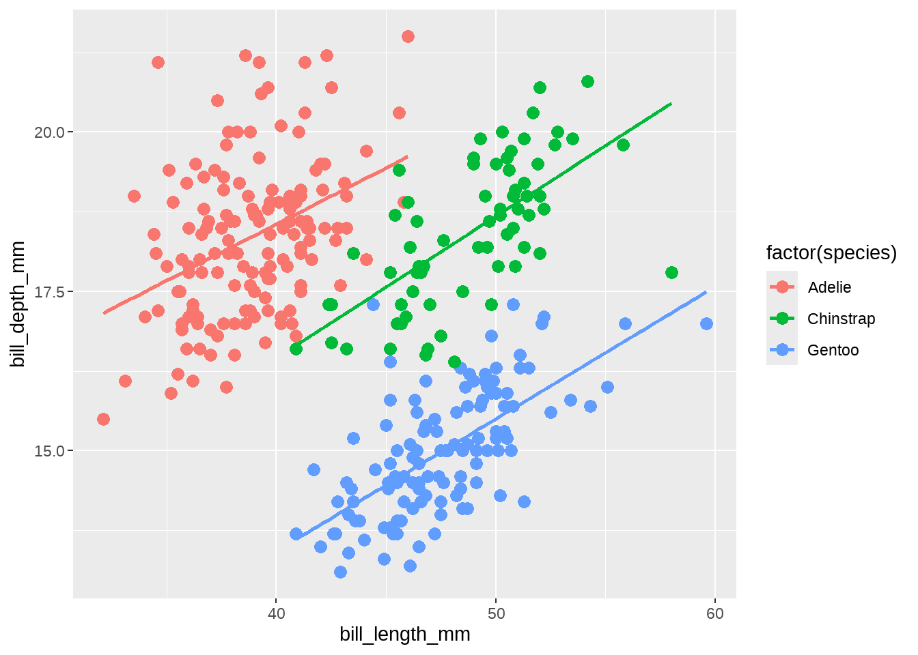
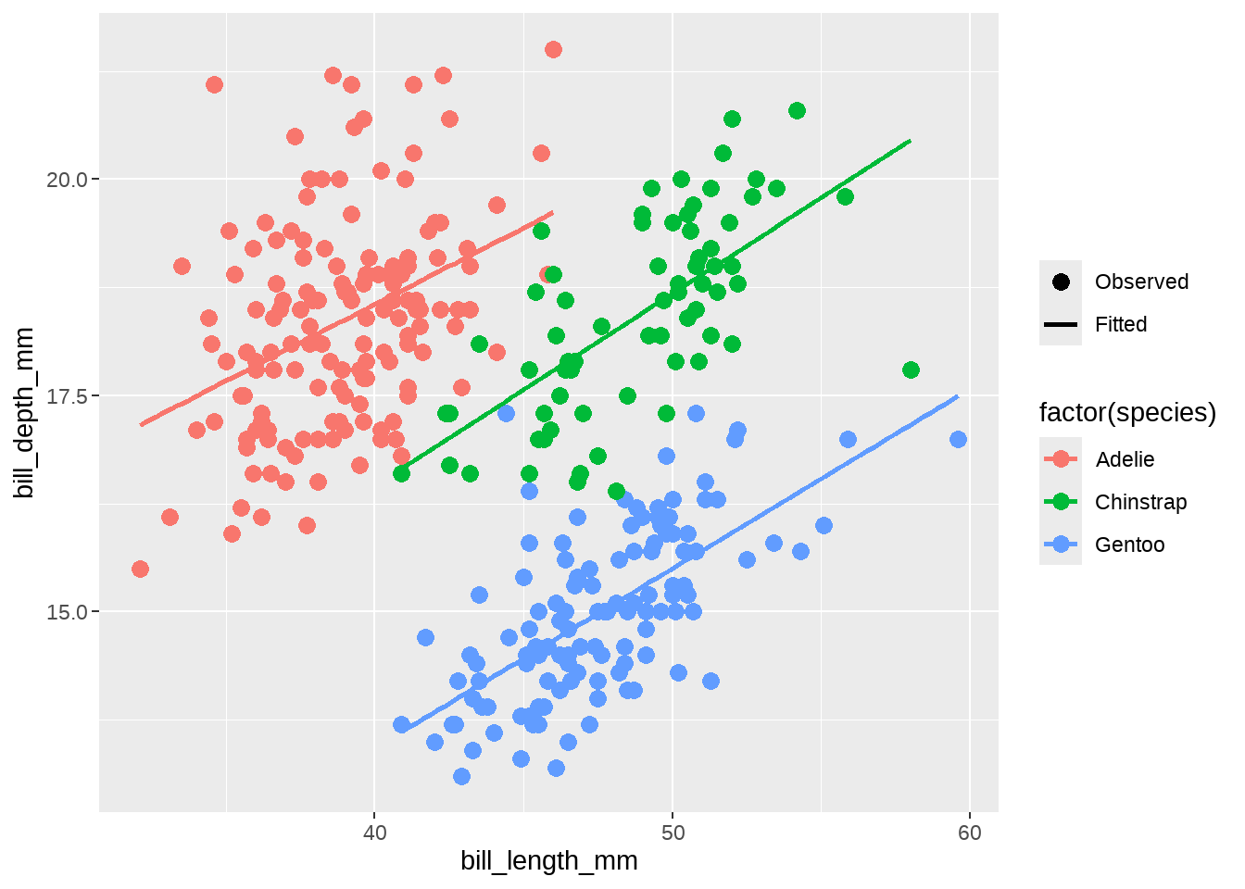
Generate different legends for different layers
How to add a legend to illustrate the original observations and the fitted line？

Slide 31
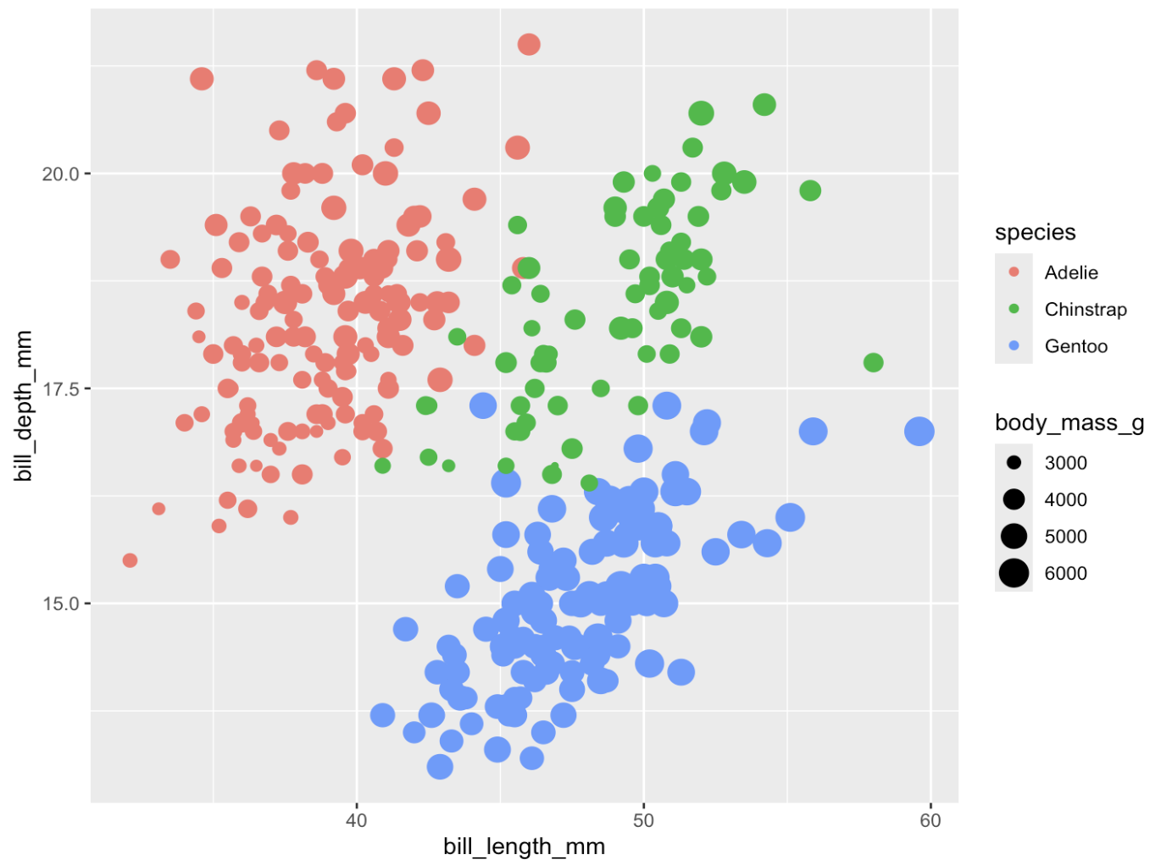
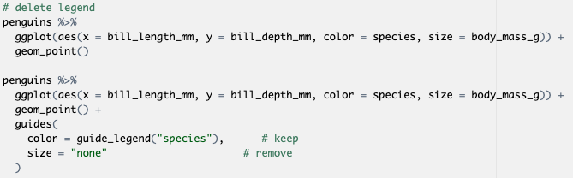
Delete the legend
Notes:
Here both color and size use the body_mass_g mapping, we can merge the two

Slide 32
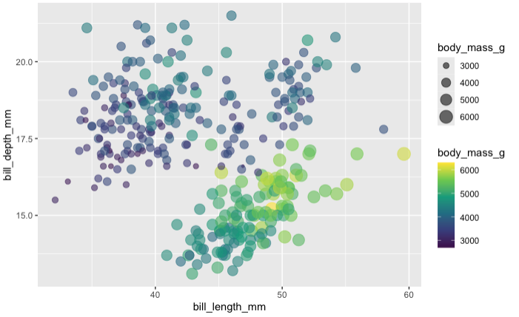
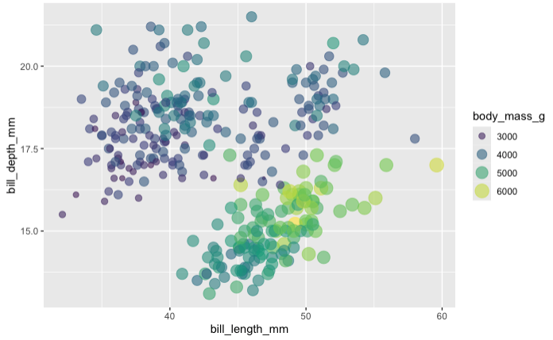
Merge the legend

Slide 33
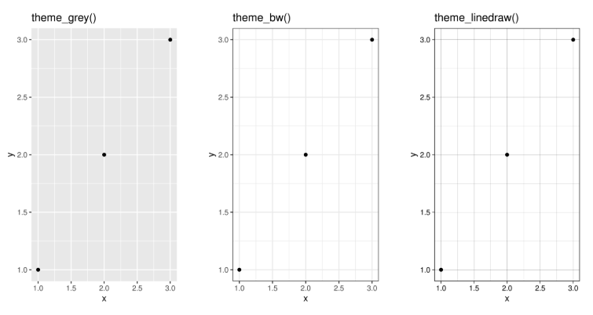
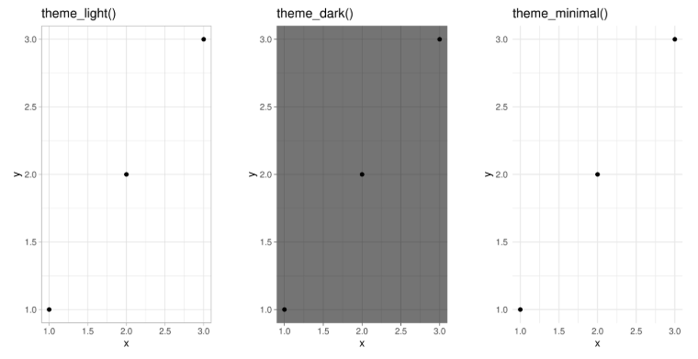
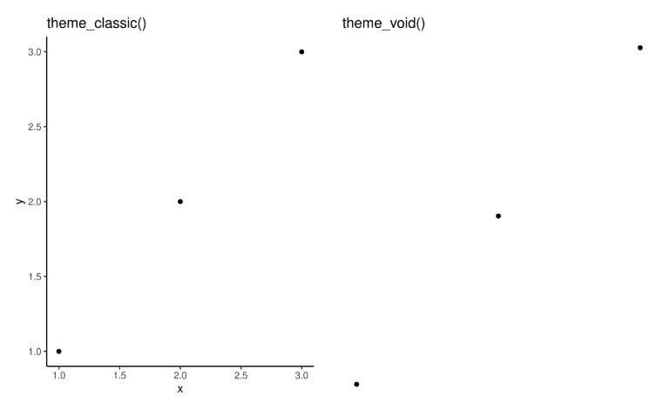
Theme
df <- data.frame(x = 1:3, y = 1:3)
base <- ggplot(df, aes(x, y)) + geom_point()
base + theme_grey() + ggtitle("theme_grey()")
base + theme_bw() + ggtitle("theme_bw()")
base + theme_linedraw() + ggtitle("theme_linedraw()")
base + theme_light() + ggtitle("theme_light()")
base + theme_dark() + ggtitle("theme_dark()")
base + theme_minimal() + ggtitle("theme_minimal()")
base + theme_classic() + ggtitle("theme_classic()")
base + theme_void() + ggtitle("theme_void()")

Slide 34

Exercise 1 (10 mins)
Improve the plot based on the following requirements
Improving the axes and legend labels
Adding a title for the plot
Tweaking the color scale to your favorite palette
The background should be white, not pale grey
Major gridlines should be a pale grey and minor gridlines should be removed
The plot title should be centered in 12pt bold text

Slide 35
Specialized Plot

Slide 36

Heatmap
Base R: heatmap() Function
ggplot2 with geom_tile()
pheatmap for Annotated Heatmaps
Correlation analysis
Feature importance in Machine Learning
Geospatial data
Gene expression data in biology
Resource utilization
Data quality checks
Comparing performance metrics
Cluster analysis
Useful materials: https://r-graph-gallery.com/215-the-heatmap-function.html
Notes:
A heatmap is like a thermal camera image, where different temperatures appear in distinct colors. Instead of temperature, it shows the intensity or correlation of values, making patterns and clusters easy to spot.
Why it is ideal:
Perfect for analyzing large-scale datasets, like gene expression or correlation matrices.
Uses color gradients to quickly reveal relationships and hidden patterns in the data.

Slide 37

Kaplan-Meier curve
survival analysis
estimate the survival probability over time
“ggsurvplot()” from survminer library is a useful function to generate KM Curve using ggplot2
Notes:
A Kaplan-Meier curve is like a long-distance race, where runners drop out (experience the event, e.g., death, failure) over time. The curve steps down each time someone "drops out," showing the survival probability at different time points.
Why it is ideal:
Clearly visualizes survival differences over time between groups (e.g., drug treatment vs. control).
The shape of the curve reveals trends in survival probability and event rates.

Slide 38

Manhattan plot
Used primarily in genome-wide association studies (GWAS) to visualize p-values across genomic positions.
Useful materials: https://r-graph-gallery.com/101_Manhattan_plot.html
Notes:
A Manhattan plot looks like a city skyline, where each "building" represents a genetic variant, and the tallest skyscrapers indicate strong associations with the trait of interest. The horizontal axis represents genomic position, and the vertical axis (−log10(p-value)) shows the strength of association.
Why it is ideal:
Easily highlights significant genetic variants that stand out from the background noise.
Allows quick identification of loci associated with diseases or traits across the genome.

Slide 39


2D density plot
A 2D density plot is a useful visualization to understand the distribution of data points over two continuous variables if you have a huge number of points.
geom_bin2d()
Useful materials: https://r-graph-gallery.com/2d-density-plot-with-ggplot2.html
Notes:
A 2D density plot works like a weather radar, where darker or more intense areas show where storms (data points) are concentrated. Instead of plotting every raindrop (or data point), it visualizes where the highest densities occur, helping reveal clustering and patterns.
Why it is ideal:
Great for handling large datasets with overplotting issues in scatter plots.
Clearly highlights regions with high concentrations of data points, making trends easier to interpret.

Slide 40
Interactive Plot

Slide 41

?
What can you observe from this plot?
Do you have any questions about this plot?

Slide 42


Check the data
Any variable could be used to further explain this polt?
Species/ Island?
What if we are still interested in individual info?

Slide 43

Try ggplotly!
What if we are interested in which island the penguin lives or any other information?
Notes:
The most awesome feature of plotly is its ggplotly() function.
Very simple to use. You are 10 seconds away to rendering an interactive version with a ready ggplot.
Just call the ggplotly() function, and you’re done.

Slide 44


Customize tooltip
Notes:
Create a new column text in the dataset that contains the information we would like to display in the tooltip using the mutate() function
Add text as an aesthetic in the ggplot() function

Slide 45


More advanced customization
Use bold text to make the tooltip more readable
Add a title to the tooltip
Change the background color of the tooltip to white
Change the font color of the tooltip to black

Slide 46

Animate your figure
Try gganimate!
Notes:
The animations are produced by transitioning between different layers of a ggplot object over time, which can be especially useful when you want to visualize changes in data or trends.

Slide 47
R Shiny Dashboard
Shiny is an R package used to build interactive web applications directly from R
Common use cases: data visualization, dashboards, interactive reports, and real-time data processing.
Structure: UI (User Interface) + server (backend logic)
UI design: fluidPage(), sidebarLayout(), ……
Shiny is reactive, which means that inputs trigger changes in the outputs

Slide 48
Let’s first see an example of R shiny dashboard to analyze Omics Data - GraphBio
http://www.graphbio1.com/en/
Notes:
The GraphBio dashboard provides 15 popular visualization analysis methods (heatmap, volcano plot, MA plot, network plot, PCA, ROC analysis, and others).
Omics stands for different disciplines in biology whose names end in “omics”, such as genomics, proteomics, metabolomics, and so on.
The dashboard enables experimental biologists without programming skills to easily perform popular visualization analysis and get publication-ready charts.

Slide 49

Skeleton of R Shiny
User interface (UI)
[define visual elements]
+
Server
[handle the reactive behavior and interactions]
Notes:
UI: define visual elements: plots, widgets
Server: handles the reactive behavior and interactions

Slide 50



Layout options
Sidebar
Tabs
Notes:
Sidebar A common layout structure in Shiny apps is the sidebar layout. This layout divides the app into a small sidebar panel on the left and a main content panel on the right.
Tabs Tabs are another effective way to organize content in your Shiny app. They provide a convenient means of switching between different sections of your app's content.

Slide 51

Placeholders
Define a placeholder for plots, tables, and text in the user interface and server side.
Plot
Table
Text
Notes:
Define a placeholder for plots, tables, and text in the user interface (ui) and server side (server).
Text can be formatted as headers (e.g., h1(), h2()) or printed in bold (strong()) or italics (em()) format.
The ggplotly() function can convert a ggplot2 plot into an interactive one (e.g., move, zoom, export image features that are not available in the standard renderPlot() function).
Similarly, the DT::dataTableOutput("table") (in the ui) and the DT::renderDataTable() (in the server) from the DT package enrich the renderTable function.

Slide 52

Control Widgets
Allow users to interact with the app
Text box
Numeric input
Slider
Range selector
Radio button
Dropdown menu (single selection/multiple selections)
Checkbox
……
More widgets: https://shiny.posit.co/r/gallery/

Slide 53

Let’s work on a simple R shiny demo!

Slide 54



How to arrange shiny in multiple pages
Use dashboardPage() in UI!
Check “shiny demo 1+2.R” to see how to combine “shiny demo 1.R” and “shiny demo 2.R” into one Shiny app.

Slide 55
Exercise 2 (15 mins)
Please select one of the example plots and use ggplotly to make it interactive. If you have time, try to create your own R shiny dashboard!

Slide 56



Friends don’t let friends make bad graphs
Don’t make violin plots for small sample sizes
Don’t make heatmap without checking outliers
Don’t use red/green and rainbow color scales
……
https://github.com/cxli233/FriendsDontLetFriends

Slide 57
Useful resources
ggplot2:
Elegant Graphics for Data Analysis (3e) https://ggplot2-book.org/
https://ggplot2.tidyverse.org/reference/
More about data visualization in R (including code, very useful!)
https://r-graph-gallery.com/
Fundamentals of Data Visualization:
https://clauswilke.com/dataviz/
Friends don’t let friends make bad graphs:
https://github.com/cxli233/FriendsDontLetFriends
R shiny:
https://shiny.posit.co/r/gallery/
https://shiny.posit.co/r/getstarted/shiny-basics/lesson1/
https://bookdown.org/weicheng/shinyTutorial/
https://www.appsilon.com/post/r-shiny-in-life-sciences-examples

Slide 58

Thank you for attending!
1
2
Leave us questions
in the InStats forum
Scan the QR code to sign up
for our mailing list
Contact: workshop-micm@mcgill.ca

Slide 59
STOP

